Slide 1
Demonstration of various operations on a lathe machine
Topic from Manufacturing Science

Slide 2
Lathe machine
A machine that is mainly designed to produce an end product from a workpiece (metal or wood) by removing extra material from it or by changing its shape by applying pressure. It consists of a revolving holder to hold and revolve the workpiece about the axis of the machine. A machine tool, which is also the part of the lathe machine is traversed along and across the workpiece to facilitate the removal of extra material from the workpiece.
Therefore, a lathe machine is supposed to be equipped with the following mechanisms:
Workpiece holding and rotation mechanism
Cutting tool holding mechanism
Feed mechanism (for traversing the tool across the workpiece)

Slide 3
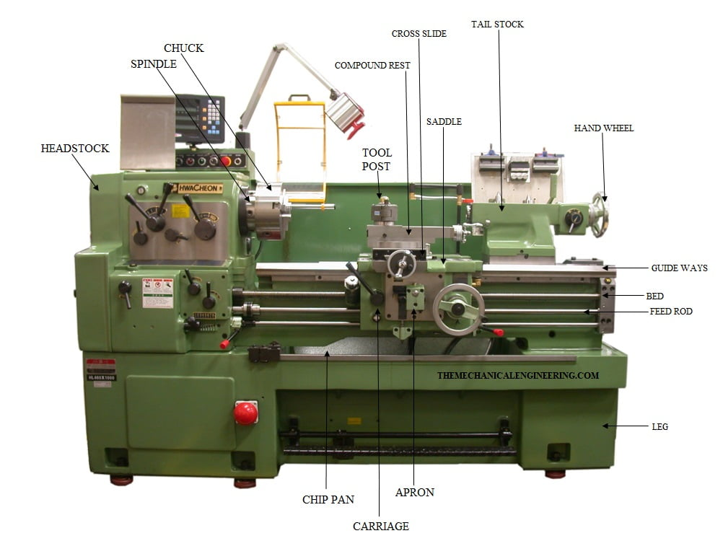
Bed
Headstock
Tail stock
Carriage
Saddle
Cross Slide
Compound rest
Tool Post
Apron
Chuck
Feed rod
Lead Screw
Spindle

Slide 4
Different lathe operations
Turning Operation
Plain or Straight Turning
Rough Turning
Shoulder Turning
Taper Turning
Eccentric Turning
Facing Operation
Chamfering Operation
Knurling Operation
Thread cutting Operation
Filing Operation
Polishing Operation
Grooving Operation
Spinning Operation
Spring Winding
Drilling
Reaming
Boring
Counter boring
Taper boring
Tapping
Internal thread cutting
Parting-off
Grinding
Milling

Slide 5
Class Work
Collect information and prepare slides on the various operations that can be performed on a lathe machine.
Slides will contain text, and figures/gif of the operations.
Presentation time will be maximum 5 minutes each.
The presentation should give a clear idea and understanding of the operation, type of cutting tool used for the operation and information regarding the movement of the workpiece and cutting tool.

Slide 6
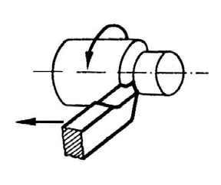
Turning operation (Plain/Straight turning)
Plain/Straight turning: Turning is the operation of removing the excess material from the workpiece to produce a cylindrical surface.
The workpiece will be mounted on the chuck.
A single point cutting tool will be used to remove material from the curved surface of the workpiece.
As a result of this operation, the diameter of the workpiece reduces.
The tool traverses parallel to the axis of rotation.
This is the most common operation that can be performed on a lathe machine.

